Slide 1

Project -01 FaceBook –Data analysis using HIVE, HDFS and MAPREDUCE.
Presenter Name: Trainer:
GAGAN N Alwyn Micaiah

Slide 2



Agenda
INPUT DATA LOCATION IN HDFS
Creating Hive table
Performing queries on Dataset :
1.find total no. of users in this fb data set
2. find out the no. of fb users above the age 25.
3. Male or female who has more number of friends in fb ?
4. How many likes does young people get compared to the older age group of people using fb? # young (13 to 25) older(above 25)
5. Find out no. of fb users for each birthday month.
6. Do young people use mobile or computer for fb browsing more frequently?
Do older people use mobile or computer for fb browsing more frequently?
Partitioning Gender column

Slide 3




Introduction
First I have created a directory in hadoop using '-mkdir‘.
Then stored the .csv excel fb data file into the sub directory 'fb' using the ambari interface.
After that inorder to check if the file exists using hdfs command '-ls' or '-cat' in that directory of hdfs.
Then I have created a table in hive with the column names (schema) for loading data from HDFS which is stored as a text file, records separated by comma.
And loaded with the fb_data from the location of hdfs.

Slide 4
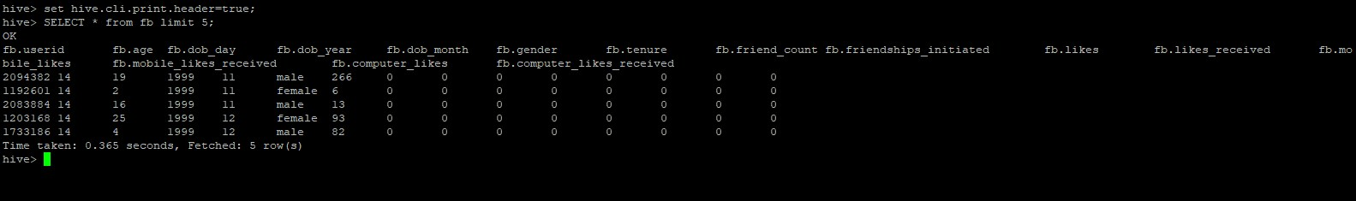
Then after loading the data to the table 'fb‘ of hive and selected all records limited by 5 rows query to display it.
Here the hive.cli.print.header is set to true. Then only the columns will be shown along with records. By default it is in OFF in hive.

Slide 5
COLUMN NAMES
userid ,age , dob_day , dob_year , dob_month , gender , tenure , friend_count , friendships_initiated , likes , likes_received , mobile_likes , mobile_likes_received , computer_likes , computer_likes_received.
QUESTIONS:
1. find total no. of users in this fb data set
2. find out the no. of fb users above the age 25.
3. Male or female who has more number of friends in fb ?
4. How many likes does young people get compared to the older age group of people using fb? # young (13 to 25) older(above 25)
5. Find out no. of fb users for each birthday month.
6. Do young people use mobile or computer for fb browsing more frequently?
7. Do older people use mobile or computer for fb browsing more frequently?

Slide 6
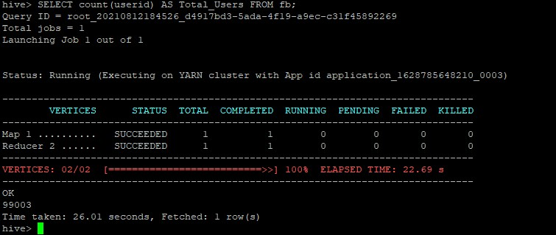
1. find total no. of users in this fb data set
It will give the total count of rows of records (users) present in this fb data.

Slide 7
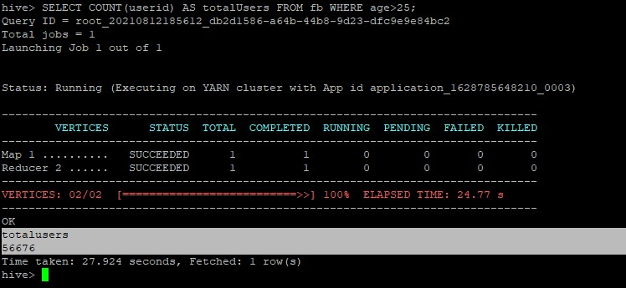
2. find out the no. of fb users above the age 25.
I have assumed the young age group as age from 13 upto 25 and older age group above 25 years old.
It will give the total count of users present in this fb data for older age group (>25 years).

Slide 8
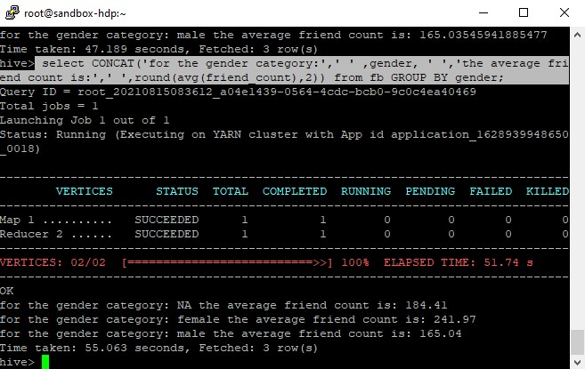
3. Male or female who has more number of friends in fb ?
There are three genders available in this data set: male, female and NA.
This query is to find the average of friends count of users of different gender groups.

Slide 9
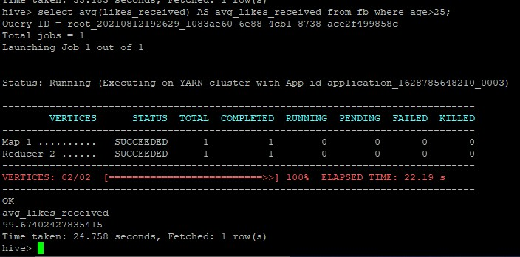
4. How many likes does young people get compared to the older age group of people using fb? # young (13 to 25) older(above 25)
Using this query we can find average of the likes received in fb posts by older age group users comparing with that of the young age group.

Slide 10
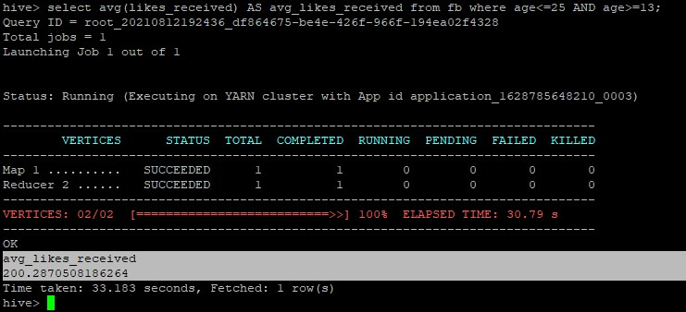
5. Find out no. of fb users for each birthday month.
Using this query we can find average of the likes received by younger group people using fb.

Slide 11
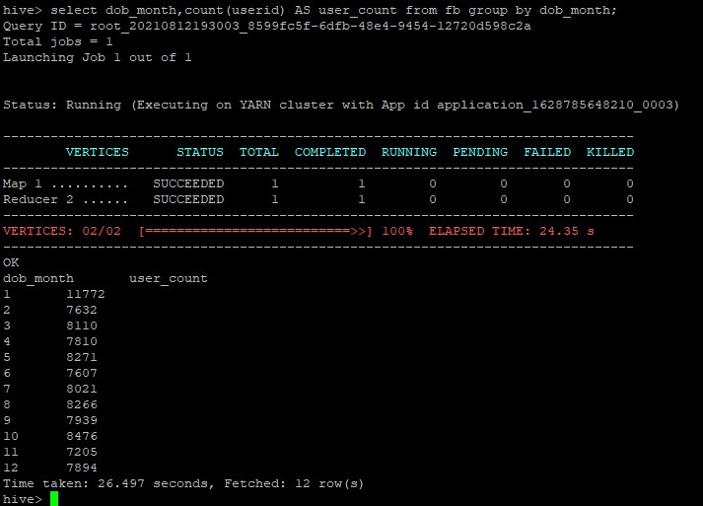
6. Do young people use mobile or computer for fb browsing more frequently?
Here we are getting the no. of users having fb account based on their birthday month.
And we can see that the users born in January are more when compared to users born in other months.

Slide 12
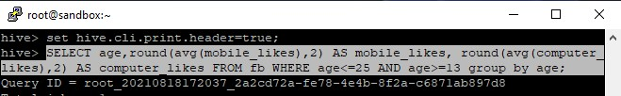
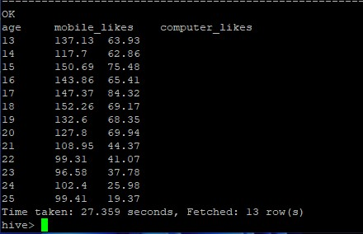
7. Do older people use mobile or computer for fb browsing more frequently?
This gives us the average no. of likes the user has given using mobile and computer for each age group from 13 to 25 (young category).
Clearly the younger people use mobile more when compared to computer for browsing in facebook.

Slide 13
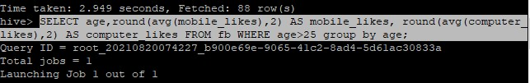
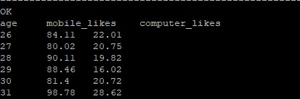
I expected that the older age group people would use computer more than mobile, but I was wrong.
Even they use mobile more than computers for facebook browsing.
But the younger people likes more post from their mobile when compared to the older age group people.

Slide 14
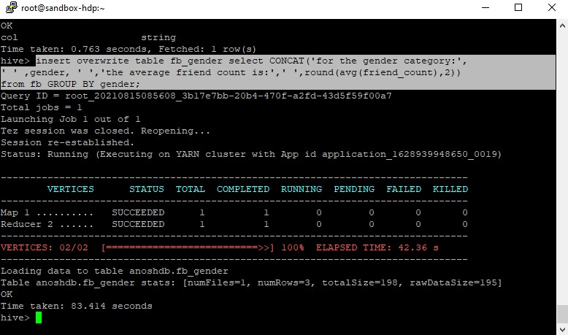
MOVING GENDER RECORDS TO SEPARATE HIVE TABLE
I moved the output records to a new hive table called "fb_gender" using this query.

Slide 15
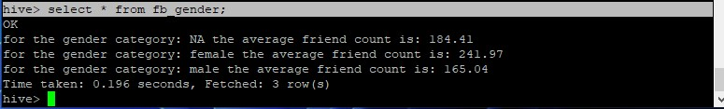
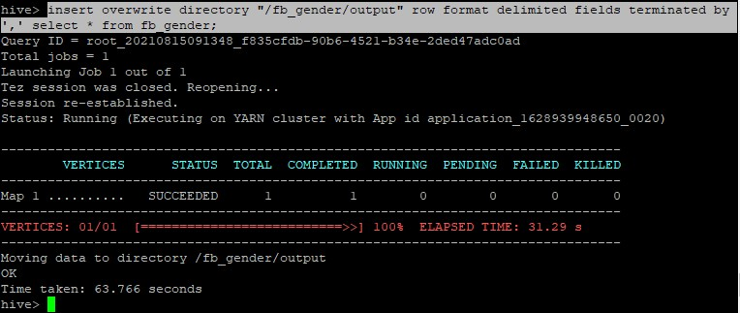
STORING GENDER RECORDS TO A HDFS DIR:
Then retrieved the records in that new output table "fb_gender" which displays the gender category and average friends count.
Now I have moved the output table "fb_gender" from hive and stored it in the directory of hadoop.
By using Insert overwrite directory.

Slide 16
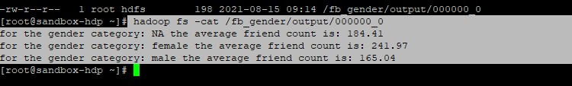
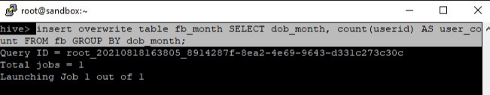
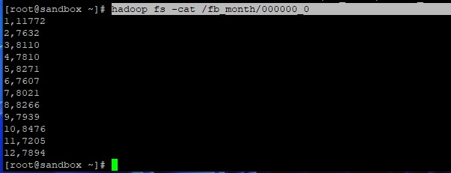
MOVING MONTH BASED USER COUNT DATA TO HIVE TABLE & STORE IN HDFS:
Seeing the content of output file from hadoop in putty using -cat command.
Users count based on their birth month data alone transfered to hdfs dir >> /fb_month/

Slide 17


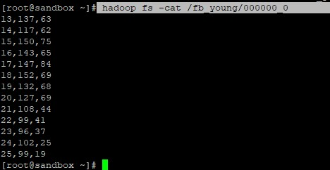
STORING YOUNG AGE DATA IN HIVE TABLE & HDFS:

Slide 18

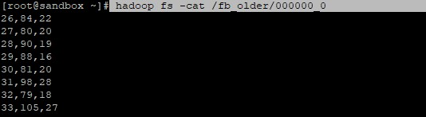
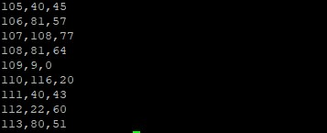
STORING OLD AGE USERS DATA IN HDFS:

Slide 19

Git hub link:
https://github.com/GAGANGURU17/Data-analysis-based-on-likes-tenure-and-age-groups-using-hive-hdfs-and-mapreduce

Slide 20


